Slide 1
Web designing
Submitted by
DEEPTHANA. R
21MATE005

Slide 2
Types of tags

Slide 3
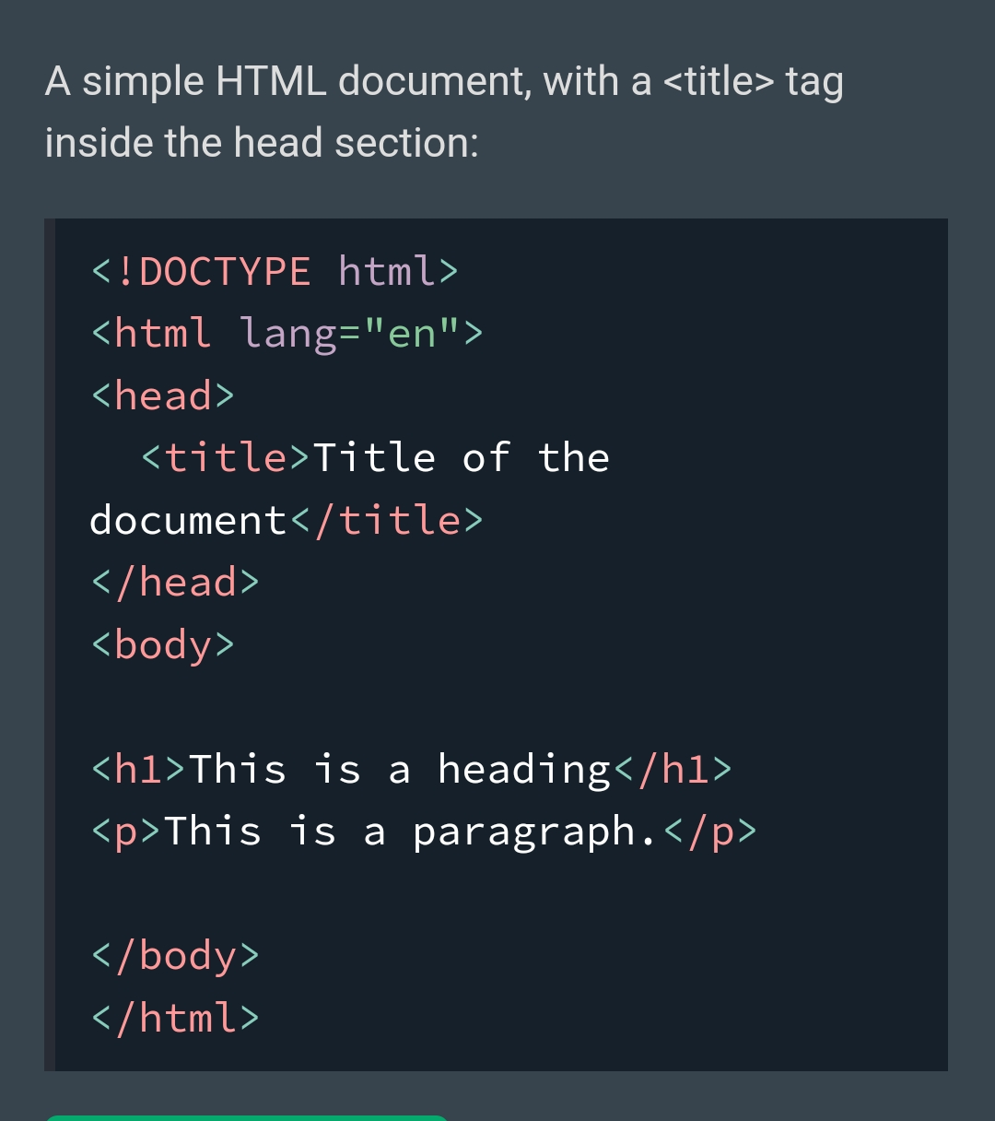
<HTML>
The <html> tag represents the root of an HTML document.
The <html> tag is the container for all other HTML elements.
<HEAD>
The <head> element is a container for metadata (data about data) and is placed between the <html> tag and the <body> tag.

Slide 4
<TITTLE>
The <title> tag defines the title of the document. The title must be text-only, and it is shown in the browser's title bar or in the page's tab.
<BODY>
The <body> tag defines the document's body. The <body> element contains all the contents of an HTML document, such as headings, paragraphs, images, hyperlinks, tables, lists, etc.
<H1> TO <H6>
The <h1> to <h6> tags are used to define HTML headings. <h1> defines the most important heading. <h6> defines the least important heading.
<P>
The <p> tag defines a paragraph. Browsers automatically add a single blank line before and after each <p> element.
<BR>
The <br> tag inserts a single line break. The <br> tag is useful for writing addresses or poems. The <br> tag is an empty tag which means that it has no end tag.

Slide 5
<ACRONYM>
The <acronym> tag was used in HTML 4 to define an acronym.
<ABBR>
The <abbr> tag defines an abbreviation or an acronym, like "HTML", "CSS", "Mr.", "Dr.", "ASAP", "ATM".
<ADDRESS >
The <address> tag defines the contact information for the author/owner of a document or an article.The contact information can be an email address, URL, physical address, phone number, social media handle, etc. The text in the <address> element usually renders in italic, and browsers will always add a line break before and after the <address> element.
<B>
The <b> tag specifies bold text without any extra imimportance.
<BDI>
BDI stands for Bi-Directional Isolation. The <bdi> tag isolates a part of text that might be formatted in a different direction from other text outside it. This element is useful when embedding user-generated content with an unknown text direction.
<BDO>
BDO stands for Bi-Directional Override. The <bdo> tag is used to override the current text direction.
<BIG>
The <big> tag was used in HTML 4 to define bigger text.

Slide 6
<CITE>
The <cite> tag defines the title of a creative work (e.g. a book, a poem, a song, a movie, a painting, a sculpture, etc.).
<CODE>
The <code> tag is used to define a piece of computer code. The content inside is displayed in the browser's default monospace font.
<DEL>
The <del> tag defines text that has been deleted from a document. Browsers will usually strike a line through deleted text.
<DFN>
The <dfn> tag stands for the "definition element", and it specifies a term that is going to be defined within the content.
<EM>
The <em> tag is used to define emphasized text. The content inside is typically displayed in italic.
<i>
The <i> tag defines a part of text in an alternate voice or mood. The content inside is typically displayed in italic.

Slide 7
<INS>
The <ins> tag defines a text that has been inserted into a document. Browsers will usually underline inserted text.
<KBD>
The <kbd> tag is used to define keyboard input. The content inside is displayed in the browser's default monospace font.
<MARK>
The <mark> tag defines text that should be marked or highlighted.
<METER>
The <meter> tag defines a scalar measurement within a known range, or a fractional value. This is also known as a gauge.
<PROGRESS>
The <progress> tag represents the completion progress of a task.
<RP>
The <rp> tag can be used to provide parentheses around a ruby text, to be shown by browsers that do not support ruby annotations.
<S>
The <s> tag specifies text that is no longer correct, accurate or relevant. The text will be displayed with a line through it.

Slide 8
THANK YOU

